Slide 1
Semester Projects at Humboldt University Berlin: Experiences with an Industry Cooperation
Klaus Bothe, Olga Schiemangk
Humboldt University Berlin
15th Workshop “Software Engineering Education and Reverse Engineering
Bohinj, Slovenia, 24th – 29th August 2015
Notes:
In this presentation, I want to report on two things:
General concept of semester projects at our institute
Experience with a special project organized in my group

Slide 2
Contents
Bachelor Curriculum at HU
Cooperation with a Company at a Semester Project during WS 2014/15
Task, Special Features and Technology
Agile Development with Scrum
Agenda and Results
Conclusion

Slide 3
Bachelor at HU: Schedule Overview
1. Semester | Fundamentals of Programmierung (OO, Java) |  | Basics of theoretical informatics |  |  |  | Mathematics 1: Linear Algebra |  | Second subject
2. Semester | Algorithms and data structures |  | Compiler construction |  | Digital systems: basics and architectures |  | Informatics and Society |  | Second subject
3. Semester | Software Engineering |  | Logic in informatics |  | Seminar |  | Mathematics 2: Analysis |  | Second subject
4. Semester | Operating systems |  | Database systems |  | Communication systems: basics and network architectures |  | Mathematics 3: Numerics & Stochastics |  | Second subject
5. Semester | Semester Project |  | Elective modules |  |  |  |  |  | Second subject
6. Semester | Bachelor thesis |  | Elective modules |  |  |  |  |  | Second subject

Slide 4
Bachelor at HU: Schedule Overview
1. Semester | Fundamentals of Programmierung (OO, Java) |  | Basics of theoretical informatics |  |  |  | Mathematics 1: Linear Algebra |  | Second subject
2. Semester | Algorithms and data structures |  | Compiler construction |  | Digital systems: basics and architectures |  | Informatics and Society |  | Second subject
3. Semester | Software Engineering |  | Logic in informatics |  | Seminar |  | Mathematics 2: Analysis |  | Second subject
4. Semester | Operating systems |  | Database systems |  | Communication systems: basics and network architectures |  | Mathematics 3: Numerics & Stochastics |  | Second subject
5. Semester | Semester Project |  | Elective modules |  |  |  |  |  | Second subject
6. Semester | Bachelor thesis |  | Elective modules |  |  |  |  |  | Second subject
Elinda Kajo-Meçe: The challenges as supervisor of students' software projects in competitions
Optional project
Obligatory

Slide 5
Semester project (from curriculum description)
Goal: gain project experience
Whole software cycle: - requirements negotiation, - find useful design, - coding, - systematic testing
Team work
Project management experience
Use of software tools
Results have to be presented
Substantial effort: 12 ECTS (i.e. 2 days per week for a semester)

Slide 6
Contents
Bachelor Curriculum at HU
Cooperation with a Company at a Semester Project during WS 2014/15
Task, Special Features and Technology
Agile Development with Scrum
Agenda and Results
Conclusion

Slide 7
Our semester project
Joint project with software company Capgemini
First semester project at the institute in
cooperation with industry since introduction in
2011 (Bachelor at HU since 2009)
Title „Development of an intermodal mobility
platform based on Salesforce“

Slide 8
Our semester project characteristics
What was special
Cooperation with a larger software company
Real-world task
Modern technologies: Salesforce (cloud)
Agile development

Slide 9
Software company „Capgemini“
One of the leading IT service providers world-wide
About 125.000 members in 44 countries
Development of individual software
German main location: Berlin
http://www.de.capgemini.com/

Slide 11
Participating students
In the beginning: 5 students
One had to be excluded (inactivity)
All of the other 4 were very satisfied at the end
Students with better performance (grades)
Unfortunately, only 4 students: distance between Institute‘s campus (Adlershof) and project meeting point at Capgemini (city center: Potsdamer Platz)

Slide 12
Contents
Bachelor Curriculum at HU
Cooperation with a Company at a Semester Project during WS 2014/15
Task, Special Features and Technology
Agile Development with Scrum
Agenda and Results
Conclusion

Slide 13
Intermodal mobility platform
Support of general travel activities - Real-world task
Assumption: private cars become less important in the future (and even today)
Task: How to move from point A to point B
using different types of transport services like
public city transport, train, airplane, car, overland bus, walk
Support of all phases of the journey (planning, payment, on the trip, waiting periods, reuse for later journeys, share with friends …)
→ Just in phase of experients and research

Slide 14
Cloud Computing Technologies used in the project
Force.com
is a „Platform as a Service“(PaaS) product
offered by Salesforce (company at California) for software development and usage (all the code stored in the „cloud“; server at Ireland)
Heroku
is a PaaS-product from Salesforce as well
provides building and deploying apps for webservices
Salesforce technologies, including the Heroku service, was recognized in the “Leader PaaS Magic Quadrant” in Gartner’s evaluation 2014 and 2015

Slide 15
Contents
Bachelor Curriculum at HU
Cooperation with a Company at a Semester Project during WS 2014/15
Task, Special Features and Technology
Agile Development with Scrum
Agenda and Results
Conclusion

Slide 16
Typical agile project: requirements not fixed in the beginning

Slide 17
Scrum: Overview
Burndown
Chart
Task Board
To Do
In
Progress
Done
Progress check in a sprint
Visualising Sprint Backlog
Daily
Scrum
Product
Backlog
Sprint
Planning
Sprint
Product
Backlog
Sprint
Backlog
Working
Software
Product
Owner
Scrum
Master
Team
Member

Slide 18
Scrum: Overview
Burndown
Chart
Task Board
To Do
In
Progress
Done
Progress check in a sprint
Visualising Sprint Backlog
List of all user stories (elementary requirements)
Meeting
Daily
Scrum
Product
Backlog
User stories for next cycle
Sprint
Planning
Sprint
Product
Backlog
Sprint
Backlog
Next cycle
Working
Software
Roles:
Developers
Customer
Product
Owner
Scrum
Master
Team
Member
Teaching in lessons cannot replace experience
Manager

Slide 19
Scrum in our project (1)
Roles:
Product owner: Capgemini
Team: students
Scrum master: somebody of the team (changing in sprints)
Schedule:
Beginning: members suggested user stories, accepted by product owner
4 sprints
Each 3 weeks

Slide 20
Scrum in our project (2)
Sprint:
Start: sprint planning meeting: selection of next user stories …
… with estimation of effort by agile points (like function points) → each team member estimates the effort, discussion and reasons, ends up with team assessment
End: sprint results presentation
Daily scrum → weekly scrum by Skype (2 times the week)

Slide 21
Contents
Bachelor Curriculum at HU
Cooperation with a Company at a Semester Project during WS 2014/15
Task, Special Features and Technology
Agile Development with Scrum
Agenda and Results
Conclusion

Slide 22
Agenda: - strict timing of activities (restriction to a semester: 16 weeks) - extended by documentation of activities, agreements, discussions

Slide 23
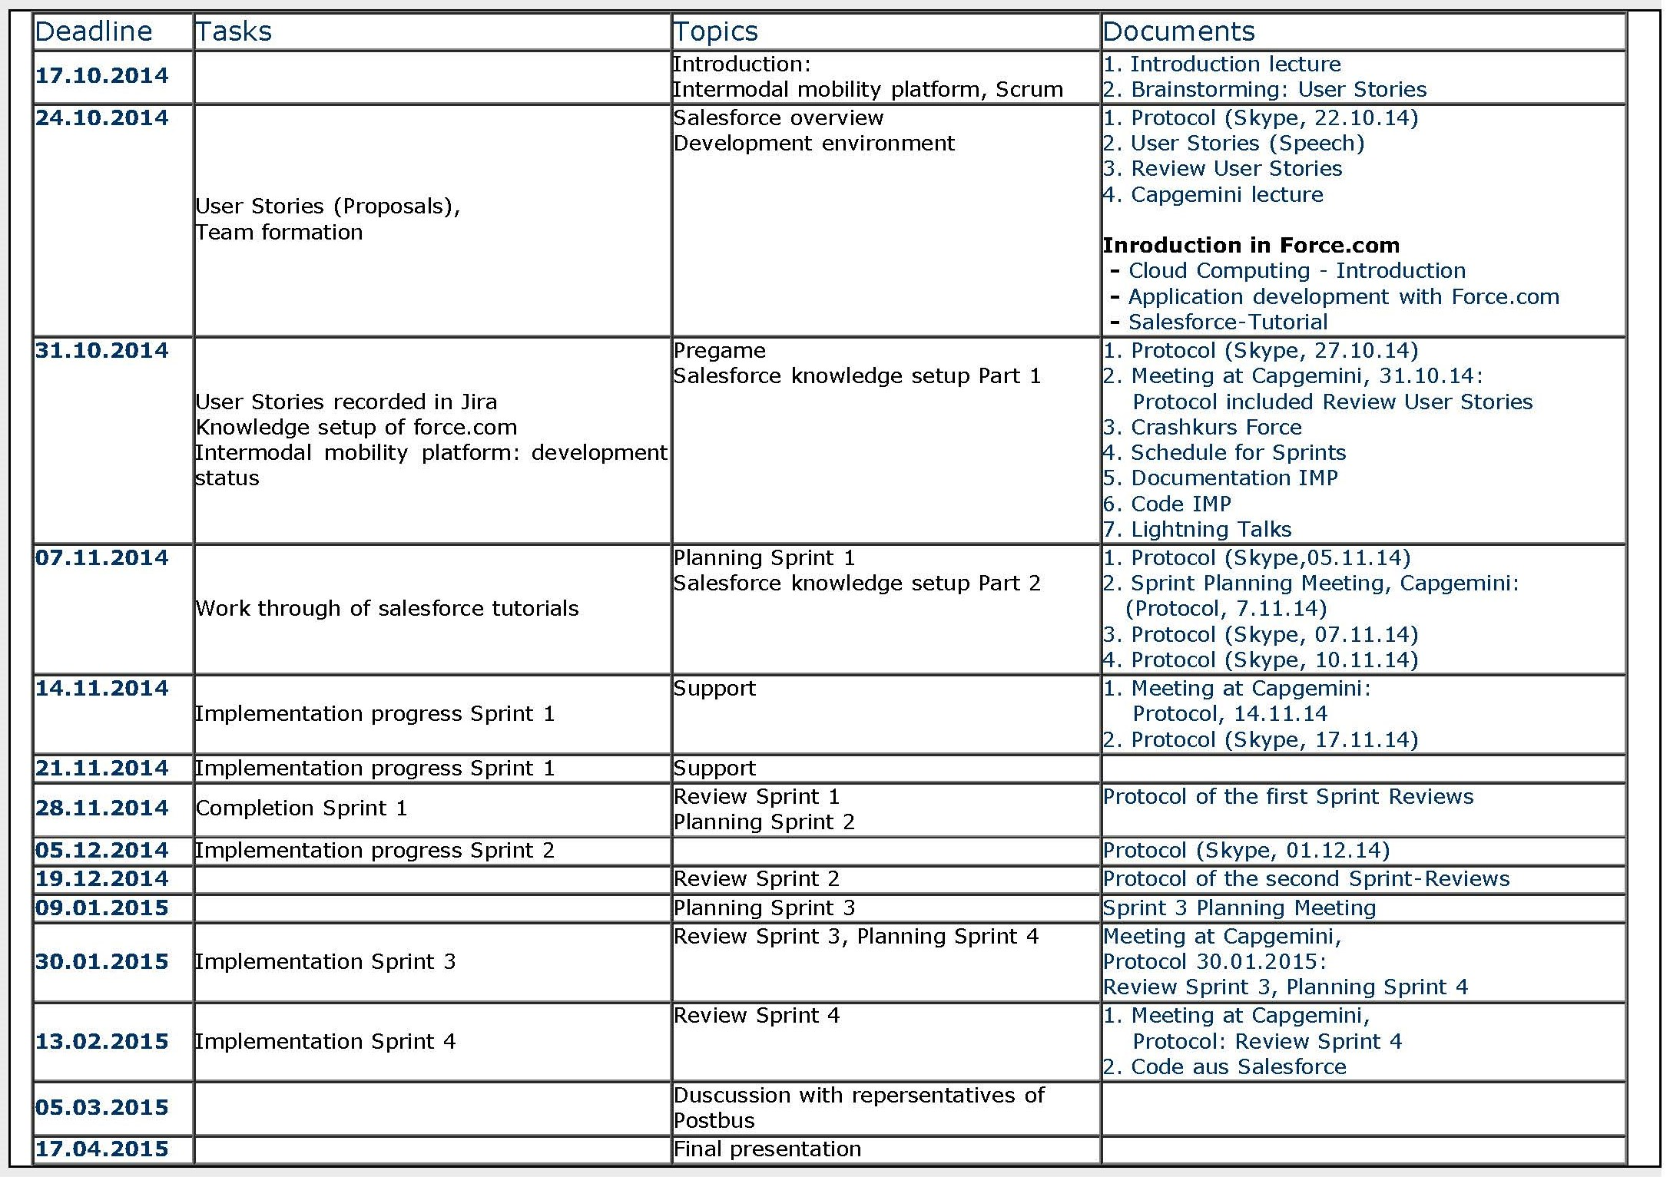
Agenda: Deadlines, Tasks, Topics, Documents

Slide 24
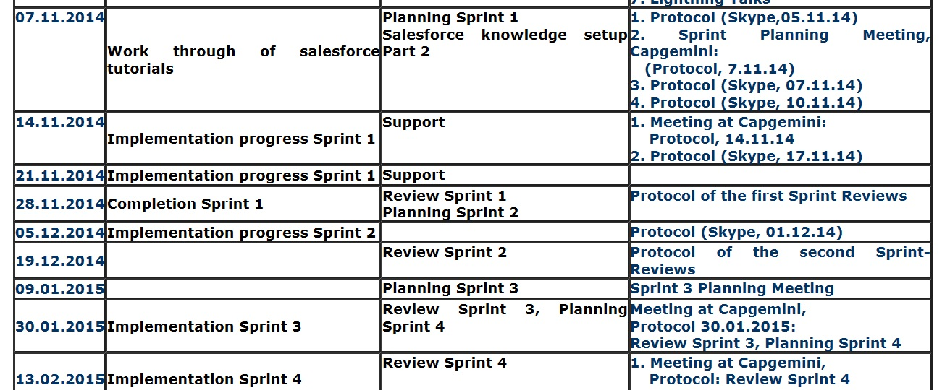
Deadlines, Tasks, Topics, Documents (excerpt)

Slide 25
Results

Slide 26
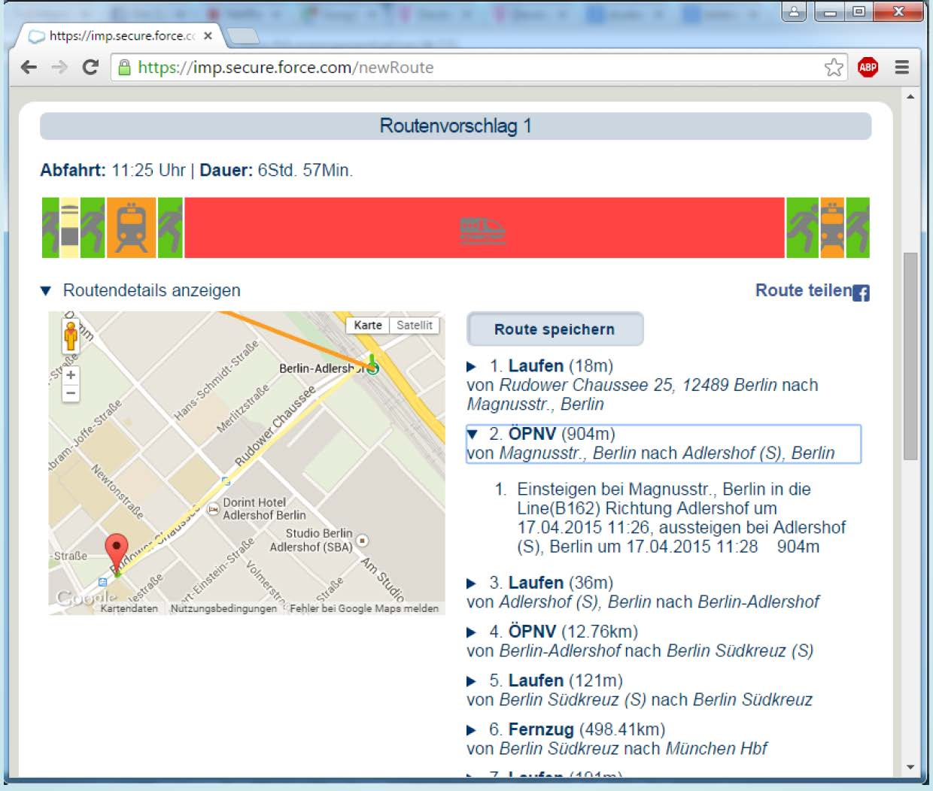
Representation of routes by timelines, textual description and GoogleMaps
Route proposal 1
Start: 11:25 | Duration: 6 h 57 min
Show details
Split route
Route description
1. Walk (18 m)
2. Tram (904 m)
3. Walk (36 m)
4. S-Bahn (12.76 km)
5. Walk (121 m)
6. Long-distance train (498.41 km)

Slide 27
Services included …
Useable at different devices: laptop, mobile app
Login and account control
Fine navigation for walking segments
Store last 10 user inquiries for reuse
Share routes via Facebook
Looking for restaurants at special points
…

Slide 28
Contents
Bachelor Curriculum at HU
Cooperation with a Company at a Semester Project during WS 2014/15
Task, Special Features and Technolgy
Agile Development with Scrum
Agenda and Results
Conclusion

Slide 29
Final public presentation …
… of all four semester projects of the institute in WS 2014/15 (event: April 2015)
… consisting of oral 20 minutes presentation of all team members …
… and demonstration of system at work.
All students and colleagues of the institute were invited (150 attendies)

Slide 30
Conclusions by our team
Especially valuable:
Development of a complex project with different technologies
Work in a professional environment at Capgemini
Practical experience of agile develoment
Teamwork, Organization of communication within the team
All team members considerably engaged
and motivated by task and environment

Slide 31
Workload
 | Irina | Jerome | Tobias | Max
Effort | 246 h | 169 h | 214 h | 182 h
(16 weeks)
Based on individual protocols
No grading (only successful participation)

Slide 32
Thank you for attention

